Slide 1
Retail
Culture &
C O N N E C T
PRODUCTIVE LEADERSHIP:
Using your tools effectively to escape daily chaos
Goodwill
Notes:
Productive Leadership

Slide 2
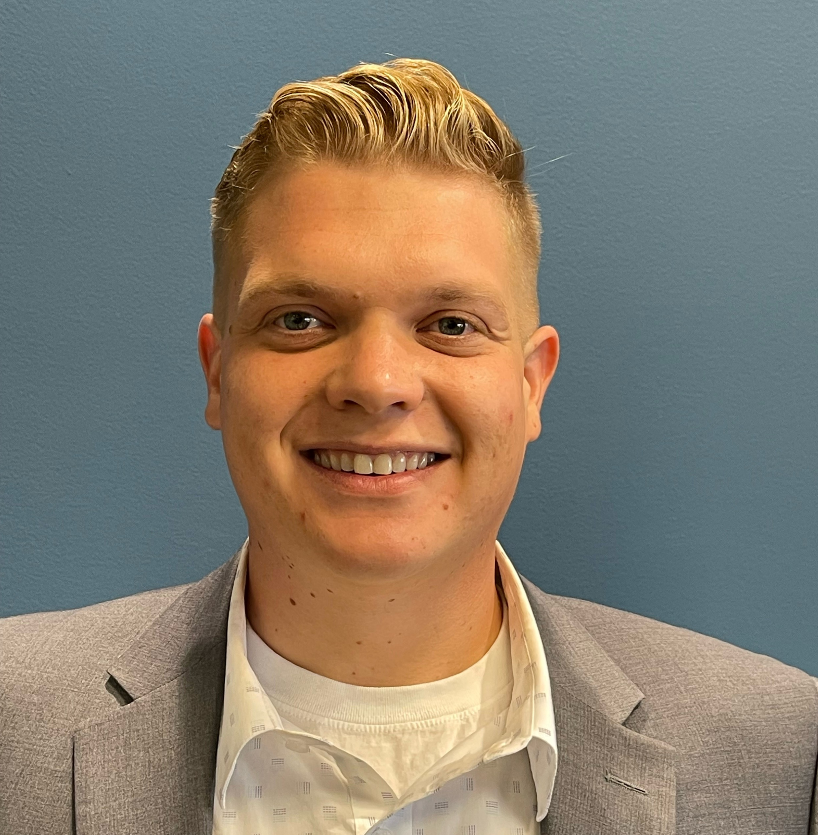
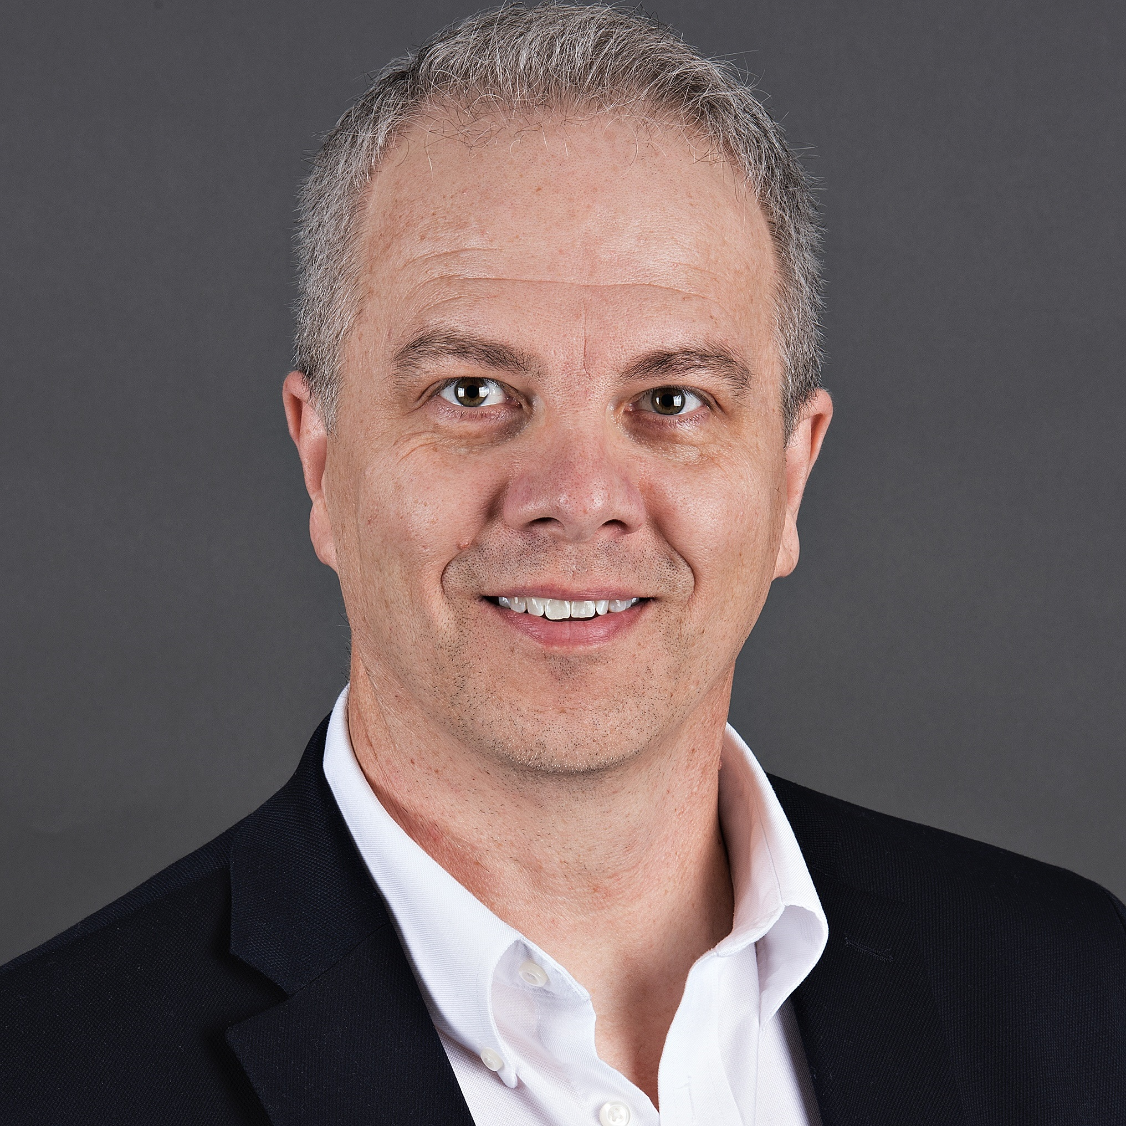
Facilitators
Dylan Chamberlain,
Retail District Manager
Rusty Rubert,
Retail Projects Manager
Goodwill
Notes:
1 min
Dylan introduces himself
Rusty Introduces himself

Slide 3
Facilitators
Breanna James,
Retail District Manager
Holly Schor,
VP of MD Operations

Slide 4
Ice Breaker
Goodwill
Notes:
5 min
** Dylan / Rusty lead Ice Breaker
Ice Breaker: Goal of Ice Breaker– Chaos happen everywhere
Identify groups based on previous job experience.
Fast Food
Retail
Convenience grocery/gas station
Thrift
Other
Potential Questions (who has ever experienced…?)
Call / Out or No show
Going Home Sick
Supply / Product Truck doesn’t Show Up
Equipment Break Down
Late for Work
Dylan- Our business is unique it is chaotic, however it is not uniquely chaotic.
There are a Million things we are expected to affect each day, the good thing is that we can anticipate most of those things. Today we will introduce, concepts and tools that can help establish routines, develop more strategic plans, and follow up with more accuracy and authority.

Slide 5
Objectives
Identify Effective Time Management Skills
Discover Productive Habits
Apply the Productivity Tools
Goodwill
Notes:
1 min
* Rusty
Introduce today’s objectives:
Productive Leadership
What it is and why it matters
Build Productive Habits / Routines
How to develop and maintain habits which will aid in your team’s success
Routines provide structure for less experienced leaders leading to successful habits
Utilize Productivity Tools
Starting Strong
Recovery Routine

Slide 6
Productive Leadership
What is Productive Leadership?
Our obligation
Observation / feedback
Leadership Ideas / Tools: Examples: time management, productive habits, tools / systems, communication
Why YOUR leadership matters
Team Vision
Team Motivation
Impacts culture, turnover, customer satisfaction, sales
Goodwill
Notes:
5 min
***Alex notes: Please have each of the three main topics come in on a separate click. Have them slide in, Also could we get some better font work
* Rusty
What is Productive Leadership?
A leader’s responsibility is the productivity of their team; change in team productivity is impacted by the leader’s continued observation, guidance, reassessment, and reassignment(s)
Leadership tools
What are common leadership tools / ideas which may aid Productive Leadership? (ask audience)
Time Management
Productive Habits
Using routines
Communication
Mindset
Why YOUR leadership matters
Motivate others to achieve more, something new, something better
Creates the vision for your team
Helps us move forward @ store level, district level, region level, Company level
Impacts Company culture, turnover, customer satisfaction, sales, revenue…et al

Slide 7
- James Clear, Atomic Habits
“
“You do not rise to the level of your goals.
You fall to the level of your systems.”
Goodwill
Notes:
Seconds
* Rusty
Read Slide (kick off to Building Productive Habits)
“You do not rise to the level of your goals. You fall to the level of your systems. ~ James Clear (Atomic Habits)

Slide 8
Productive Habits
Why are Productive Habits important
Life = sum of your habits
Structure & Dependability
Developing Productive Habits
Have a goal / expected outcome
Make it easy to execute
Plan for roadblocks
Reward behaviors
Applying Productive Habits
Prepare
First Things First
Shortcuts for Success / Use a feedback loop
Goodwill
Notes:
5 min
***Alex notes: Please have each of the three main topics come in on a separate click. Have them slide in, Also could we get some better font work,
Rusty
Why are Productive Habits Important?
Life (work / business) is the sum of your habits. Change habits, change your life
Structure and dependability can lead to sustained, repeatable results
Developing Productive Habits
Have a goal / expected outcome
Make it easy to execute
Plan for roadblocks
Reward behaviors (a simple thank you, a traveling floor work trophy, have fun…(audience suggestions).
Applying Productive Habits
Prepare (gather tools, know the expected result, eliminate distractions)
Focus on the most important task first
Find and use repeatable shortcuts
Use a feedback loop
Have a plan (what is the desired outcome and how are you going about it)
Observe (collect data)
Analyze (review data collected)
Share Results (communicate and discuss)
Course Correct (make changes, as needed

Slide 9
Using Productivity Tools:
Starting Strong
Morning Routine
Establishing Productive Habits at Goodwill
Starting Strong
Goodwill
Notes:
6 min
Alex notes: Font work, This is content light, I will be adding some additional bullets from the notes below, please anticipate some additional work.
Dylan
Intro Paragraph
Introduce the concept that running production, running a back room is a marathom not a sprint.
Re-state the definition of productive habits as defined on previous slide.
"Rusty spoke about productive habits, and we agreed, that these habits can have a big change on your in your ability to leade repeatable results, and most importantly sustain those results over time.
How do we establish productive habits at Goodwill?
"today we will introduce a tool that will help you to develop these habits"
Starting Strong
Starting Strong was developed in store by retail leaders and refined and updated by the DM team to ensure that we are building in routines to create habits that yield results.
There are a lot of things that we ask you to keep in your scope, and it can be hard to remember and plan for everything.
Demonstrate how starting strong takes the guesswork out of how to wrap your hand around everything.
Use example of pulls to discuss how difficult it is to retain visibility without a plan, and how starting strong turns it into second nature.
Explain how by installing non negotiable expectations as second nature or "habit" then we can move the focus of your leadership to the next level, solving more complex problems, and developing ourselves and teams.
Provide second example of how starting strong helps, I am thinking seasonal tags, and walking off station for PPM at 9:30. How this could ensure seasonal.

Slide 10
“
“People often complain about lack of time when lack of direction is the problem.”
-Zig Ziglar
Goodwill
Notes:
Seconds
* Rusty
Read Slide (kick off to Time Management Skills)
“People often complain about lack of time when lack of direction is the problem.” ~ Zig Ziglar

Slide 11
Building Routines
Manage Time Wisely / Execute the Plan
24 hours - that’s it!
Task time allowance
Evaluate and address opportunities
What is a Routine?
Series of behaviors frequently repeated
Identify / Overcome Roadblocks
Conditions which interfere with performance
Two way communication
Importance of planning
Goodwill
Notes:
5 min
Rusty
Manage Time Wisely / Execute the Plan
24 hours - that’s it!
Task time allowance
Evaluate and address opportunities
You’ve all heard of time management, you know it’s something you ought to be doing, and yet it’s often the very thing which prevents us from moving ahead individually and collectively. More specifically, there are times throughout each day when things are expected to be complete, these tasks or assignments have designated time allotments (or standards), and you can evaluate team speed and success based on performance related to expected pace. This is why having a routine is so important
What is a Routine
Helpful way to Prioritize tasks (what is important / what gives biggest bang for buck?)
Use to delegate tasks– who does what / who can or should get things done most effectively?
Limit distractions – stay focused on singular tasks (modern Neuroscience has proved multi-tasking is a myth. When multi-tasking the brain switches back and forth using more energy and using up valuable working memory resources). Rather than multi-task, prioritize and order your flow to move obstacles or distractions appropriately to get more done.
Series of behaviors frequently repeated vs habit - instinctual, performed without thought and largely subconscious
Identify and Overcome Roadblocks
Conditions that interfere with an employee’s motivation or ability to perform
Examples of constraints
Training, Poor instructions, lack of equipment or supplies
Do not establish routines without identifying and resolving roadblocks
Frequent two way communications – check for understanding, provide coaching when needed
Remove obstacles – have a plan, FOLLOW the plan, have the supplies/tools needed

Slide 12
Using Productivity Tools:
Recovery Routine
Building a Closing Routine
Recovery Routine
Goodwill
Notes:
6 min
Dylan
The difference in tools
We gave a tool "starting strong" for your Sm/asm and opening routine
Starting strong is prescriptive, and should translate to habits quickly.
Closing routine is a collection of task that must be completed, this will help develop a routine, installing routines, and maniging those routines, is a crucially important tool for new managers to include in their toolbox.
Why is it different
Stores have different recovery needs based on PM sales, customer base, volume, staffing ect
Working out your leadership muscle by developing daily routines.
How the tool does this.
The tool increases your visibility. Were not expecting all csm or even asm levels to remember everything, This tool keeps your scope wide so you can keep your focus os assigned the task and following up with the team.
You cant begin to assemble a routine if you don’t know the ingredients, and Why I cant provide you the step by step recipe, We can ensure that you have everything you need for success.

Slide 13
Activity:
A Day in the Life
Goodwill
Notes:
30min
* Dylan, Rusty, TAs
A Productive Day
Opening Process
Production Routines
Closing Process
Activity – Day in the Life
Progressive puzzles (must complete one to advance to the next)
Floor Work Puzzle – where to start
Small envelope handed to each table
Inside:
5i report
Production Standards handout
A word problem is written out – Goal : We have a preset time for how long it takes to conduct floor work & one to determine where to start. Use the tools provided to determine where and how long to conduct floor work
Once complete, tell TA the answer as though assigning them the tasks. If correct, TA will provide next envelope
Task Timeline (order tasks/cards appropriately)
Small envelope handed out
Inside:
6-10 retail tasks written on cards
Tools ?
Teams must work together to order the tasks correctly
-Flipchart with badge holders, or tape.
Overcoming Closing Obstacles
Leading a team (Moving a unit as one)
Closing Tasks using the closing checklist
Xxx

Slide 14
Conclusion
Identify Effective Time Management Skills
Discover Productive Habits
Apply the Productivity Tools
Goodwill
Notes:
1 min
* Rusty
Introduce today’s objectives:
Manage Time Effectively
Why it is important and high-level introduction of a few techniques which can assist you
Build Productive Habits
How to develop and maintain habits which will aid in your team’s success
Utilize Productivity Tools
Routines, checklist (better word agenda, program, timeline)

Slide 15
“
Questions?
”
Goodwill
Notes:
What are some key takeaways from the session?

